Slide 1
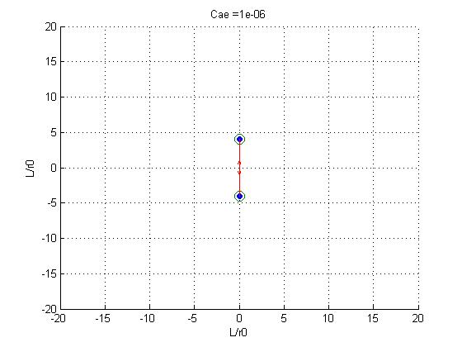
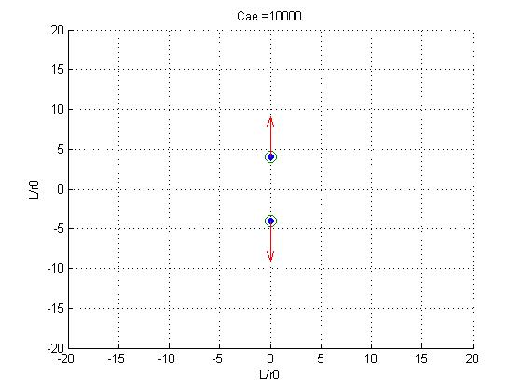
R = [ 0 4 0 1/2 0; 0 -4 0 1/2 0];
1.0e-03 *
0 0.9766
0 -0.9766
0 -1.9064
0 1.9064

Slide 2
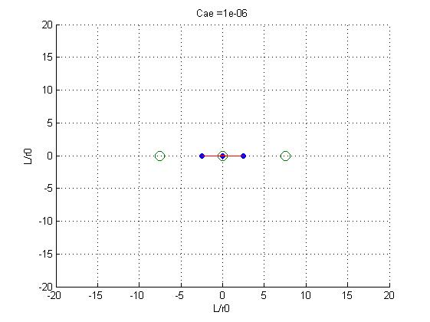
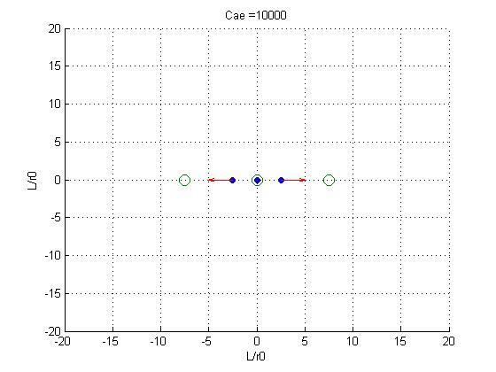
R = [ -2.5 0 0 1/2 0; 0 0 0 1/2 0; 2.5 0 0 1/2 0];
-0.1024 0
0 0
0.1024 0
639.8976 0
0 0
-639.8976 0

Slide 3
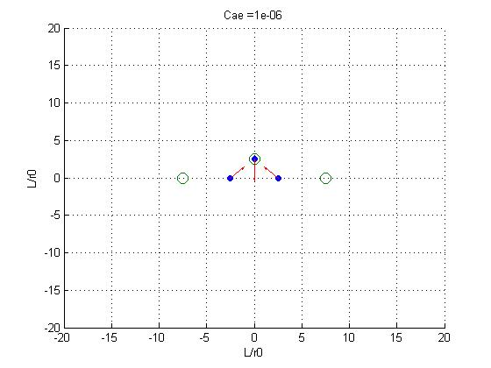
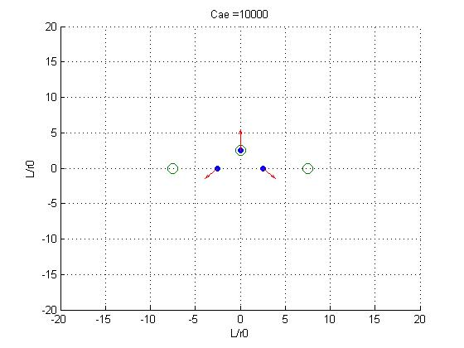
R = [ 0 2.5 0 1/2 0; -2.5 0 0 1/2 0; 2.5 0 0 1/2 0];
0 -161.2431
79.9819 79.9819
-79.9819 79.9819
0 0.0369
-0.0181 -0.0181
0.0181 -0.0181

Slide 4
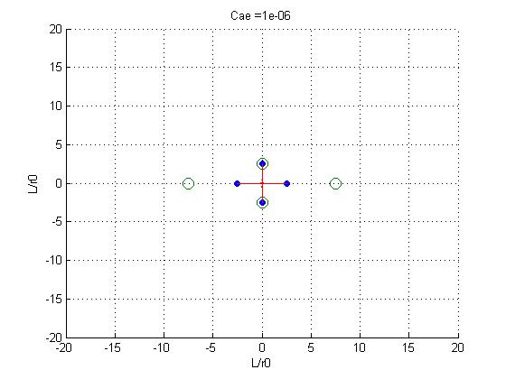
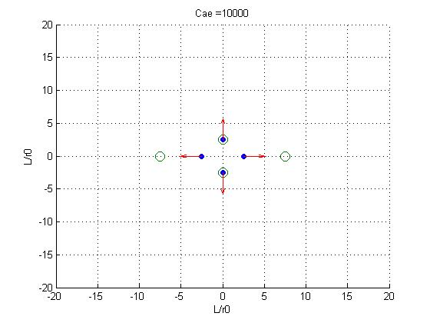
R = [ 0 2.5 0 1/2 0; -2.5 0 0 1/2 0; 2.5 0 0 1/2 0; 0 -2.5 0 1/2 0];
0 -181.2367
159.9638 0
-159.9638 0
0 181.2367
0 0.0433
-0.0362 0
0.0362 0
0 -0.0433

Slide 5
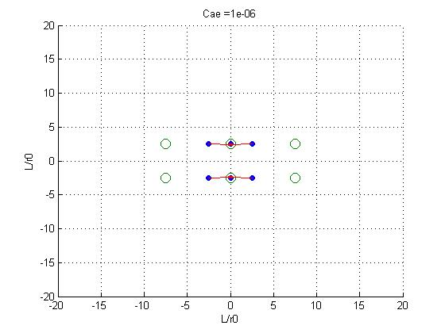
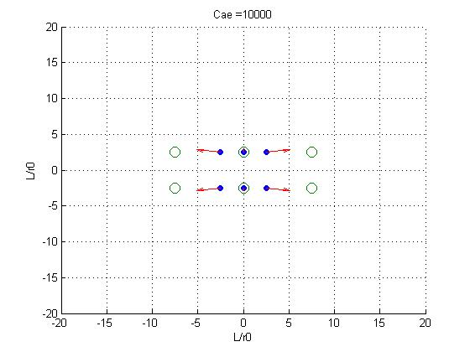
R = [ 0 2.5 0 1/2 0; 0 -2.5 0 1/2 0; -2.5 -2.5 0 1/2 0; -2.5 2.5 0 1/2 0;...
2.5 -2.5 0 1/2 0; 2.5 2.5 0 1/2 0];
0 -41.6308
-0.0000 41.6308
645.3355 35.3876
645.3355 -35.3876
-645.3355 35.3876
-645.3355 -35.3876
-0.0000 0.0144
0.0000 -0.0144
-0.1045 -0.0124
-0.1045 0.0124
0.1045 -0.0124
0.1045 0.0124

